Slide 1
Reinforcement Learning
Greg Placencia, PhD

Slide 2
What is Reinforcement Learning (RL)?
Agent must be able to partially/fully sense environmental states and take actions to influence the environment state
The state is typically described with a feature-vector
Digital agents
Interact in a specific environment
Achieve a long-term goal
Relate to the state of the environment
Learn what to do (and what not to do) by trial and error
Receive rewards or penalties to reinforce or discourage certain behaviors
Goal defined by maximized reward signal

Slide 3
4 Elements of Reinforcement Learning
Policy
Reward function
Value function
Environmental model (optional)

Slide 4
Types of Reinforcement
Positive
Event, occurs due to a particular behavior
increases the strength and the frequency of the behavior
Maximizes Performance
Sustain Change for a long period of time
Too much Reinforcement can overload states that can diminish the results
Negative Strengthening behavior to stop or avoid a negative condition
Increases Behavior
Provide defiance to minimum performance standard
Only provides enough to meet up the minimum behavior

Slide 5
Types of Reinforcement Learning
Upper confidence bounds
Balances exploration and exploitation through its selection mechanism
Thompson learning
Uses ​​exploration and exploitation for the purpose of choosing actions that would maximize the rewards earned

Slide 6
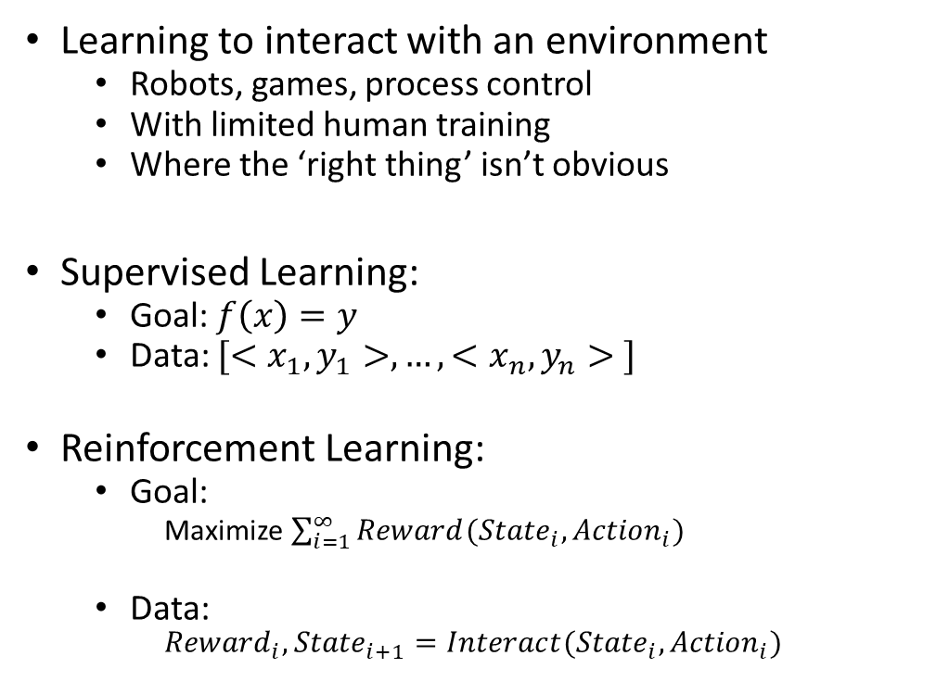
Reinforcement Learning
Learning to interact with an environment
Robots, games, process control
With limited human training
Where the ‘right thing’ isn’t obvious
Supervised Learning:
Goal: $f\left(x\right)=y$
Data: ${[<x}_{1},y_{1}>, …, {<x}_{n},y_{n}> ]$
Reinforcement Learning:
Goal:
Maximize $\sum_{i=1}^{∞}{Reward({{State}_{i}, Action}_{i})}$
Data:
$${Reward}_{i}, {State}_{i+1}=Interact({State}_{i},{Action}_{i})$$
Agent
Reward
State
Action
Environment

Slide 7
Exploration versus Exploitation
Reinforcement learning agent should earn rewards
Agent prefers past actions found to producing reward
Agent exploits what it already knows to obtain reward
Agent selects untested actions to discover reward-producing actions
Agent explore actions to select better future actions
Trade-off between exploration and exploitation

Slide 8
Policy
Mapping from perceived environmental states to actions to be taken when in those states
Reinforcement learning agent uses a policy to select actions given the current environment state

Slide 9
Reward Signal
Defines the goal
Indicates short term gain/good
On each time step, the environment sends a single number called the reward to the reinforcement learning agent
Agent’s objective to maximize total reward it receives overall
Reward signal used to alter the policy

Slide 10
Value Function
Value function indicates long term gain/good
Value of a state is the total expected reward, it will accumulate from that state into the future
Compute the value using
current states
Most likely states that should follow
Rewards when changing states
Future rewards may be time-discounted with a factor interval [0, 1]

Slide 11
Value Function (cont)
Use the values evaluate and make decisions
Action choices based on value judgements
Prefer actions with highest values states instead of highest reward
Rewards come directly from the environment
Must continually re-estimate values based on the sequence of observations an agent makes over its lifetime

Slide 12
What is Deep Reinforcement Learning?
Standard reinforcement learning that uses a deep neural network to approximate a policy or a value function
Require lots of real/simulated interaction with the environment to learn
Lots of trials/interactions used in simulated environments
Can easily run parallel trials/interaction in simulated environments
Cannot do this in robotics (no simulations)
action execution takes time
accidents/failures are expensive
safety concerns

Slide 13
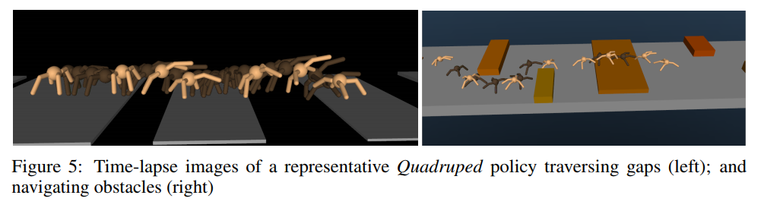
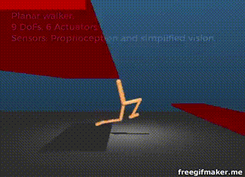
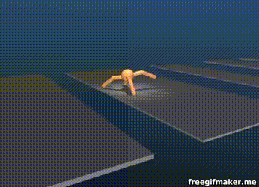
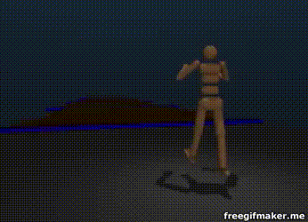
Robotics and Locomotion
State:
Joint States/Velocities
Accelerometer/Gyroscope
Terrain
Actions: Apply Torque to Joints
Reward: Velocity – { stuff }
https://youtu.be/hx_bgoTF7bs
2017 paper https://arxiv.org/pdf/1707.02286.pdf

Slide 14
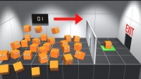
Example
https://www.youtube.com/watch?v=v3UBlEJDXR0

Slide 15


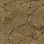
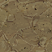




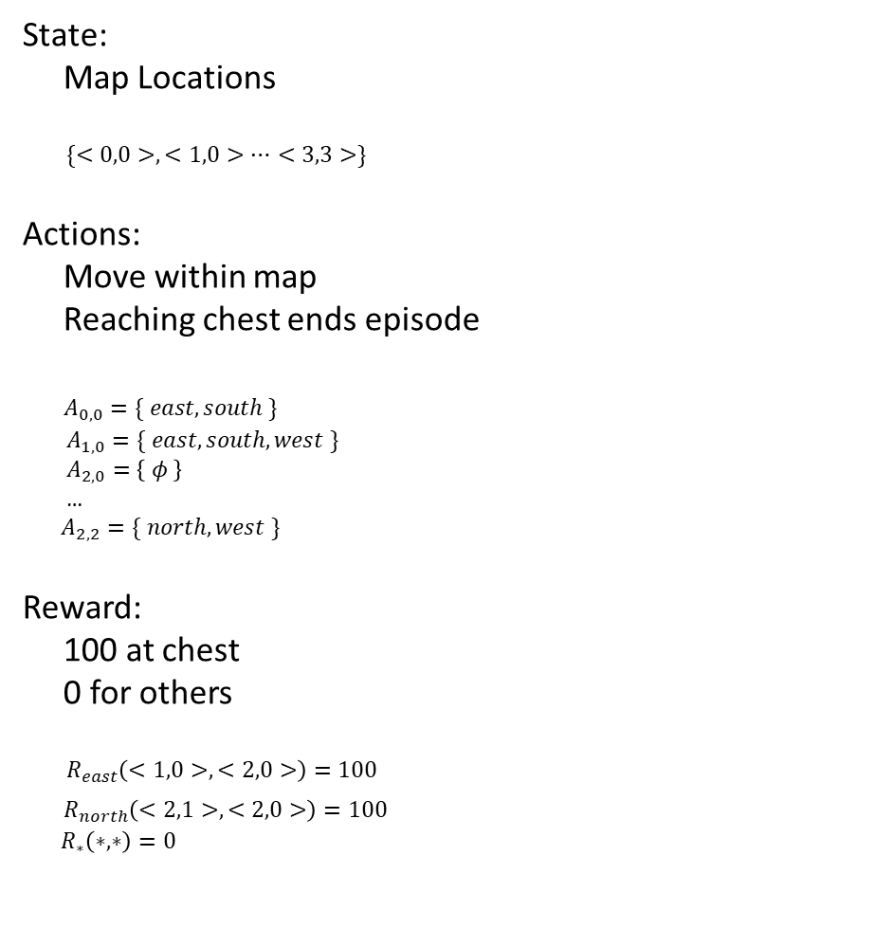
Simple Example of Agent in an Environment
State:
Map Locations
$\{<0,0>, <1,0>…<3,3>\}$
Actions:
Move within map
Reaching chest ends episode
$A_{0,0}=\{ east, south \}$
$A_{1,0}=\{ east, south, west \}$
$A_{2,0}=\left\{ φ \right\}$
…
$A_{2,2}=\{ north, west \}$
Reward:
100 at chest
0 for others
$R_{east}\left(<1,0>, <2,0>\right)=100$
$R_{north}\left(<2,1>, <2,0>\right)=100$
$R_{∗}\left(∗, ∗\right)=0$
Score: 0
Score: 100
0, 0
1, 0
2, 0
100
0, 1
1, 1
2, 1
0, 2
1, 2
2, 2

Slide 16
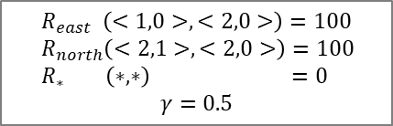
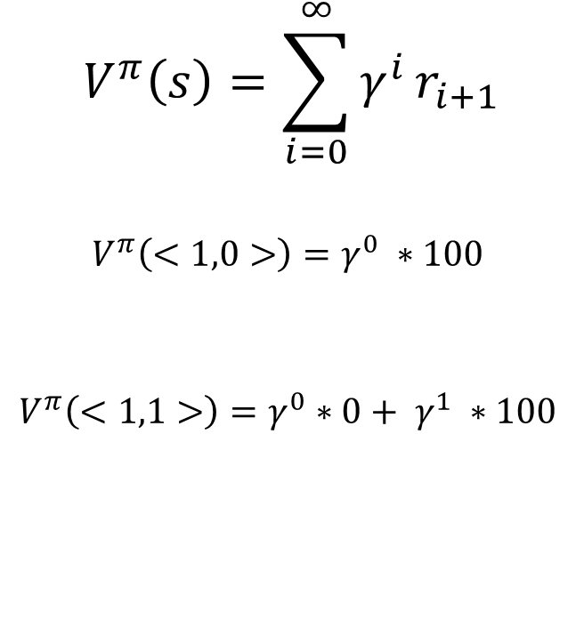
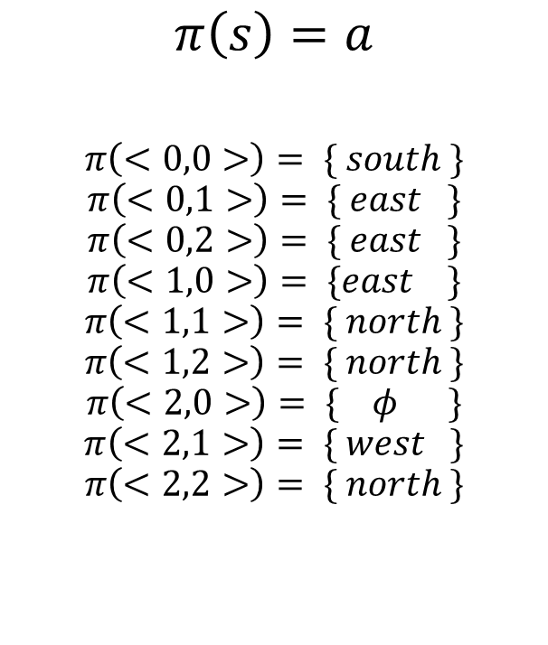
Policies
$R_{east} \left(<1,0>, <2,0>\right)=100$
$R_{north}\left(<2,1>, <2,0>\right)=100$
$R_{∗} \left(∗, ∗\right) =0$
$$γ=0.5$$
Policy
Evaluating Policies
$$π\left(s\right)=a$$
$$π\left(<0,0>\right)= \{ south \}$$
$$π\left(<0,1>\right)= \{ east \}$$
$$π\left(<0,2>\right)= \{ east \}$$
$$π\left(<1,0>\right)= \{east \}$$
$$π\left(<1,1>\right)= \{ north \}$$
$$π\left(<1,2>\right)= \{ north \}$$
$$π\left(<2,0>\right)= \{ φ \}$$
$$π\left(<2,1>\right)= \{ west \}$$
$$π\left(<2,2>\right)= \{ north \}$$
0, 0
1, 0
2, 0
$$V^{π}\left(s\right)=\sum_{i=0}^{∞}{γ^{i}}r_{i+1}$$
$$V^{π}\left(<1,0>\right)=γ^{0} ∗100$$
$$V^{π}\left(<1,1>\right)=γ^{0}∗0+ γ^{1} ∗100$$
12.5
100
0, 1
1, 1
2, 1
50
0, 2
1, 2
2, 2
Move to <0,1>
Move to <1,1>
Move to <1,0>
Move to <2,0>
$$V^{π}\left(<0,0>\right)=γ^{0}∗0+ γ^{1} ∗0+γ^{2} ∗0+γ^{3} ∗100$$
Policy could be better

Slide 17
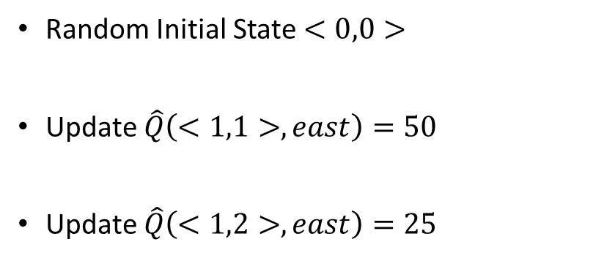
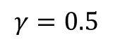
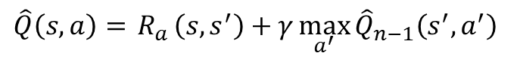
Example of Q learning (some acceleration…)
$\hat{Q}\left(s,a\right)={ R}_{a}\left(s, s^{′}\right)+γ\max_{a^{′}}{{\hat{Q}}_{n−1}\left(s^{′},a^{′}\right)}$
$$γ=0.5$$
Random Initial State $<0,0>$
Update $\hat{Q}\left(<1,1>,east\right)=50$
Update $\hat{Q}\left(<1,2>,east\right)=25$
0, 0
1, 0
2, 0
0
0
0
0
0
0
0
100
0, 1
1, 1
2, 1
0
0
50
0
0
0
0
0
0
50
0
0, 2
1, 2
25
2, 2
0
0
0
0

Slide 18
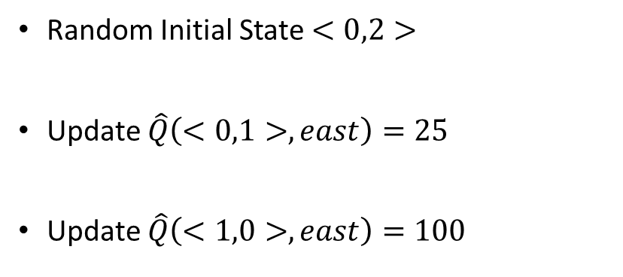
Example of Q learning (some acceleration…)
$\hat{Q}\left(s,a\right)={ R}_{a}\left(s, s^{′}\right)+γ\max_{a^{′}}{{\hat{Q}}_{n−1}\left(s^{′},a^{′}\right)}$
$$γ=0.5$$
Random Initial State $<0,2>$
Update $\hat{Q}\left(<0,1>,east\right)=25$
Update $\hat{Q}\left(<1,0>,east\right)=100$
0, 0
1, 0
2, 0
0
100
0
0
0
0
0
0
100
0, 1
1, 1
2, 1
25
0
50
0
0
0
0
0
0
50
0
0, 2
1, 2
25
2, 2
0
0
0

Slide 19
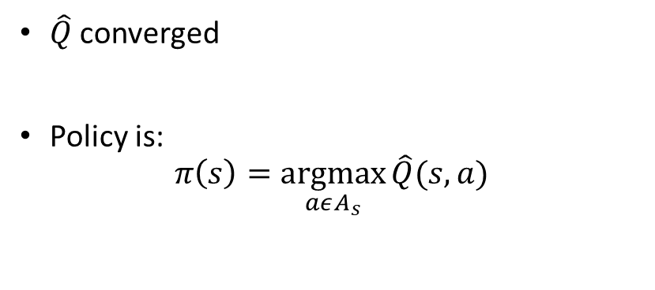
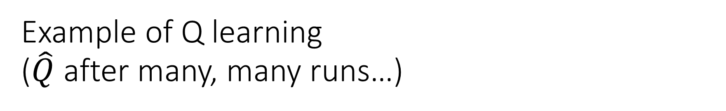
Example of Q learning ($\hat{Q}$ after many, many runs…)
0, 0
1, 0
2, 0
$\hat{Q}$ converged
Policy is:
$$π\left(s\right)=\underset{aεA_{s}}{argmax}{\hat{Q}(s,a)}$$
50
100
12.5
25
25
25
50
100
0, 1
1, 1
2, 1
25
50
6.25
12.5
12.5
25
25
12.5
25
50
0, 2
1, 2
2, 2
12.5
25
6.25
12.5

Slide 20
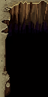
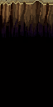
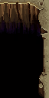
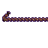
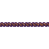

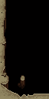


Challenges for Reinforcement Learning
Many states and actions
Episode can end without reward
‘Narrow’ path to reward
Turns Remaining: 15
Each step ~50% probability of going wrong way – P(reaching goal) ~ 0.01%
Random exploring will fall off of rope ~97% of the time

Slide 21
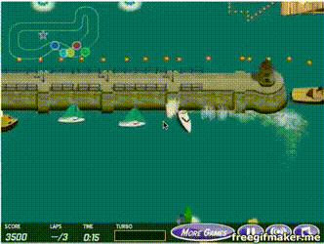
Reward Shaping
Hand craft intermediate objectives that yield reward
Encourage right type of exploration
Require custom human work
Risks of learning to game the rewards

Slide 22
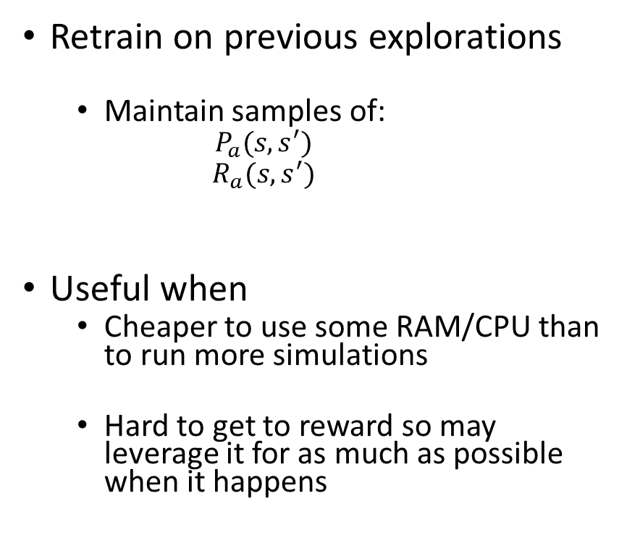
Memory
Retrain on previous explorations
Maintain samples of:
$$P_{a}(s, s^{′})$$
$$R_{a}(s, s^{′})$$
Useful when
Cheaper to use some RAM/CPU than to run more simulations
Hard to get to reward so may leverage it for as much as possible when it happens
0, 0
1, 0
2, 0
0
50
100
0
0
0
0
25
0
50
100
0, 1
1, 1
0
25
2, 1
0
0
50
0
0
0
0
0
0
0
25
25
50
0
0, 2
1, 2
25
2, 2
0
0
0
12.5
0
Replay it a bunch of times
Do an exploration
Replay a different exploration
Replay it a bunch of times

Slide 23
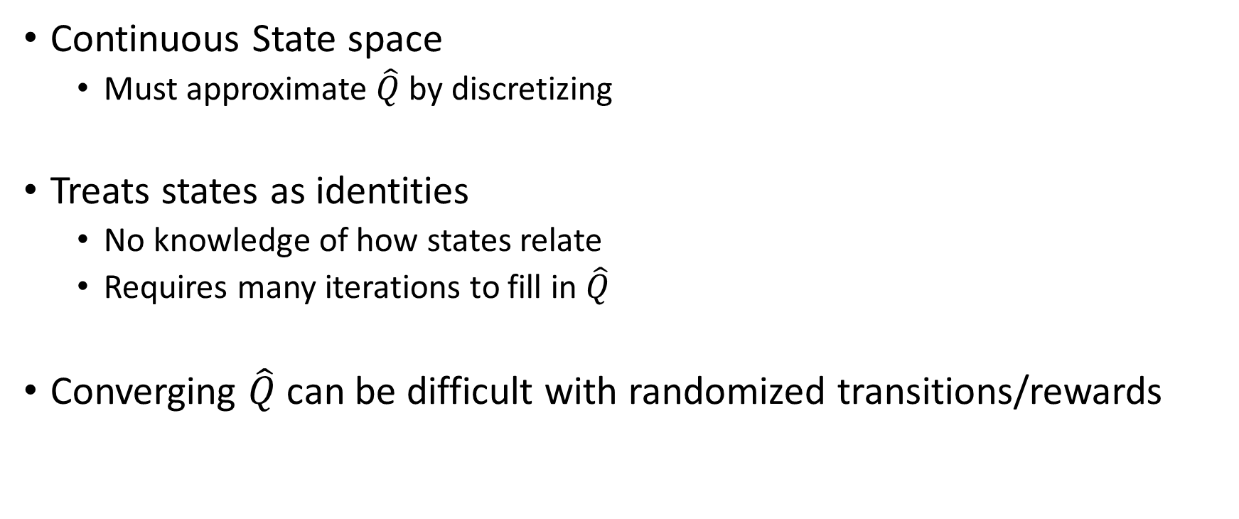
Some Problems with QLearning
Continuous State space
Must approximate $\hat{Q}$ by discretizing
Treats states as identities
No knowledge of how states relate
Requires many iterations to fill in $\hat{Q}$
Converging $\hat{Q}$ can be difficult with randomized transitions/rewards

Slide 24
References

